Slide 1
VISION
CONNECTING BUSINESSES WITH CUSTOMERS
SCHAUMBURG MARKETPLACE
Schaumburgmarketplace.com
Who : Sellers, and Buyers, People’s, Wholesale, businesses.
What : Products
Why : To offer Traditional, Unique, Affordable and Quality Products.
When : Developed and functioning Website.

Slide 2
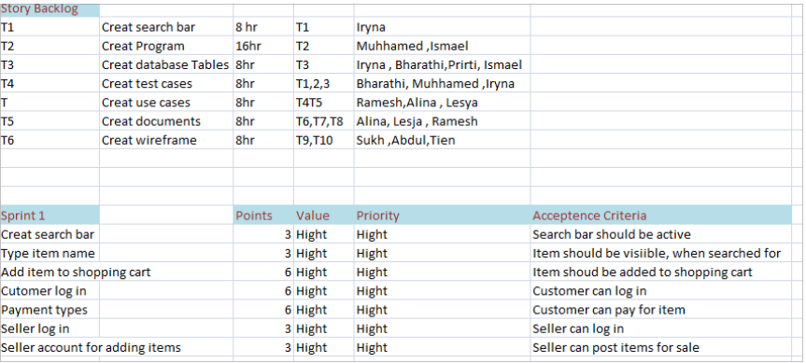
RELEASE PLAN

Slide 3
PRODUCT BACKLOG
USER STORY ID | EXPLAINATION | SPRINT | PRIORITY | POINT
US01 | I want to be able to upload Indian traditional PRODUCTS. | 1 | HIGH | 5
US02 | I want a search bar so the customer can easily find the desired product | 1 | HIGH | 8
US03 | I want a forum tab where customer can ask questions. | 2 | MEDIUM | 5
US04 | As a user I want to be able to create an account so I can purchase item | 3 | MEDIUM | 3
US05 | As a customer I want to be more user friendly so I can understand and use the web site better | 4 | MEDIUM | 3
US06 | As a customer I would like to see a 360 view of the product so that I can see all sides of it. | 3 | MEDIUM | 2

Slide 4
EPIC
ID | NAME | PRIORTY | SIZE | VALUE | COMMENT
EPIC 1 | SEARCH BAR | HIGH | L | 14.5 BILLIONS | CUSTOMER CAN SEARCH PRODUCT
EPIC 2 | SHOPPING CART | HIGH | XL | 14.5 BILLION | ITEMS IN THE CART
EPIC 3 | BUYER PROFILE | HIGH | XL | 14.5 BILLION | BUYER CAN LOGIN INTO THEIR PROFILE.
EPIC 4 | SELLER PROFILE | HIGH | XL | 14.5 BILLIONS | SELLER CAN MAKE THEIR PROFILE AND SELL THEIR PRODUCT.
EPIC 5 | LIST OF PRODUCTS | HIGH | XL | 14.5 BILLION | CUSTOMER CAN VIEW ALL PRODUCTS SEARCHED

Slide 5
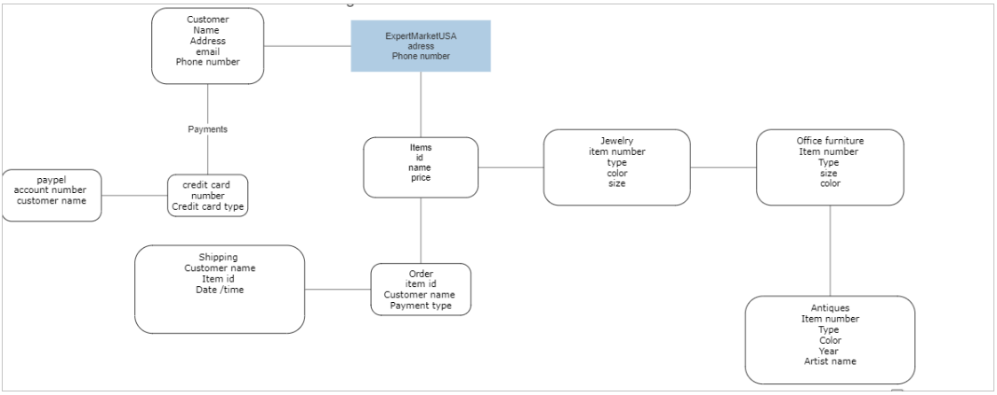
ERD Search Bar Related to Customer

Slide 6
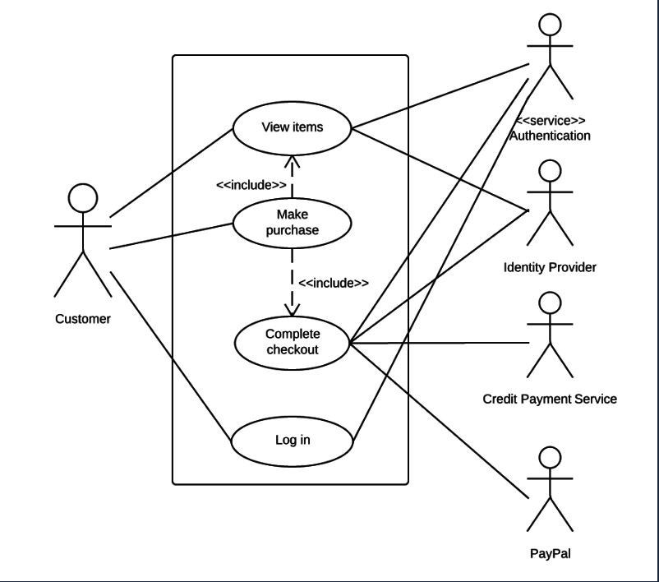
User Diagram

Slide 7
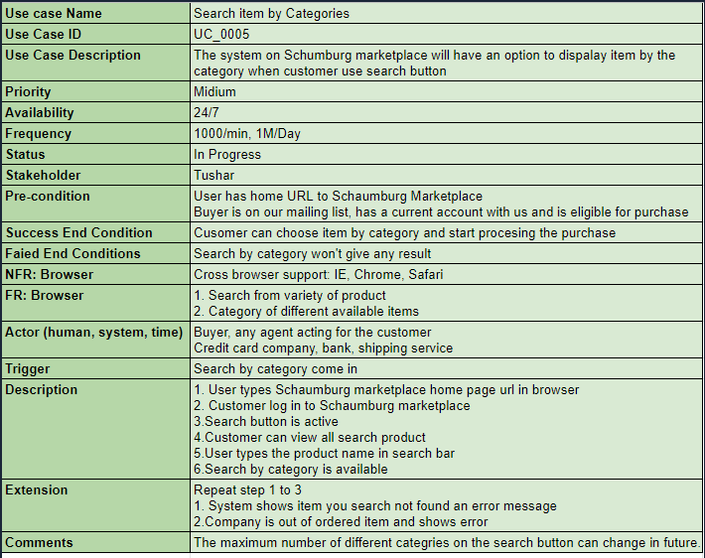
Use Case

Slide 8
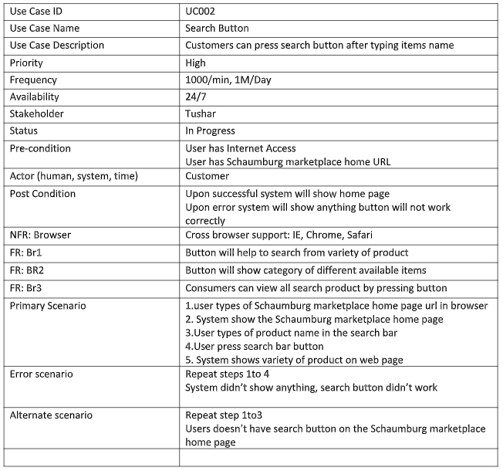
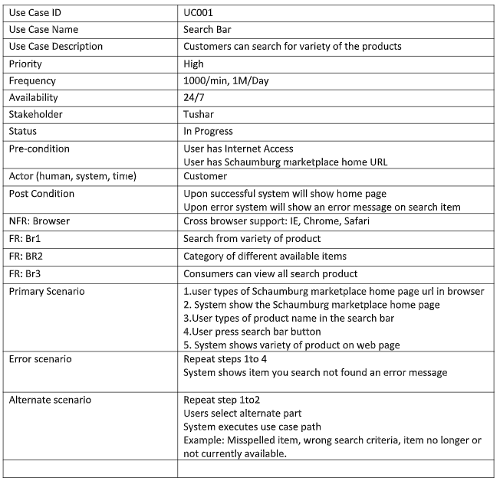
Uses Case

Slide 9
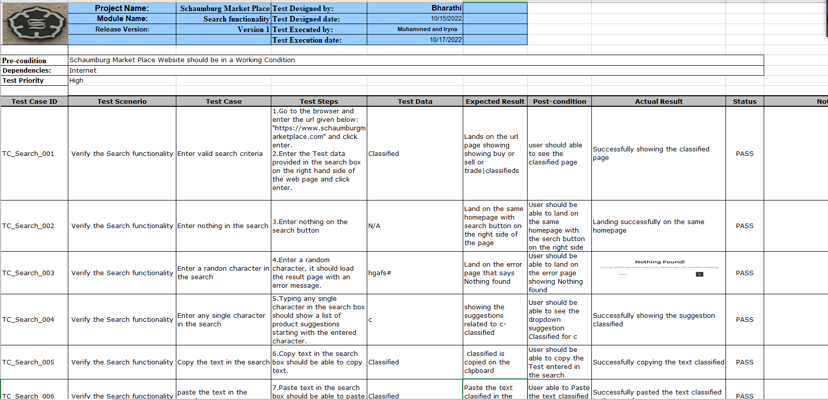
Test Cases

Slide 10
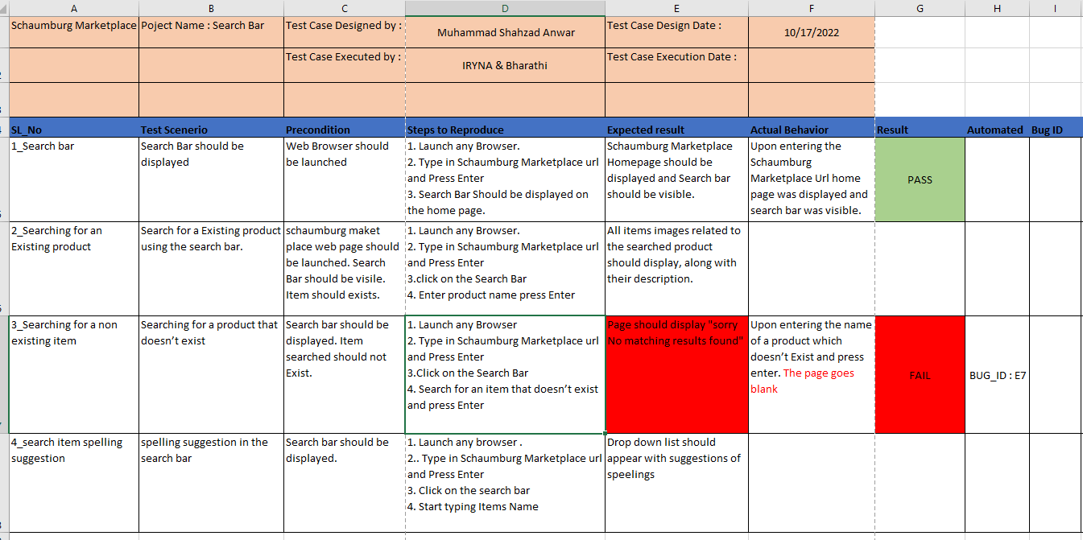
Test Case

Slide 11
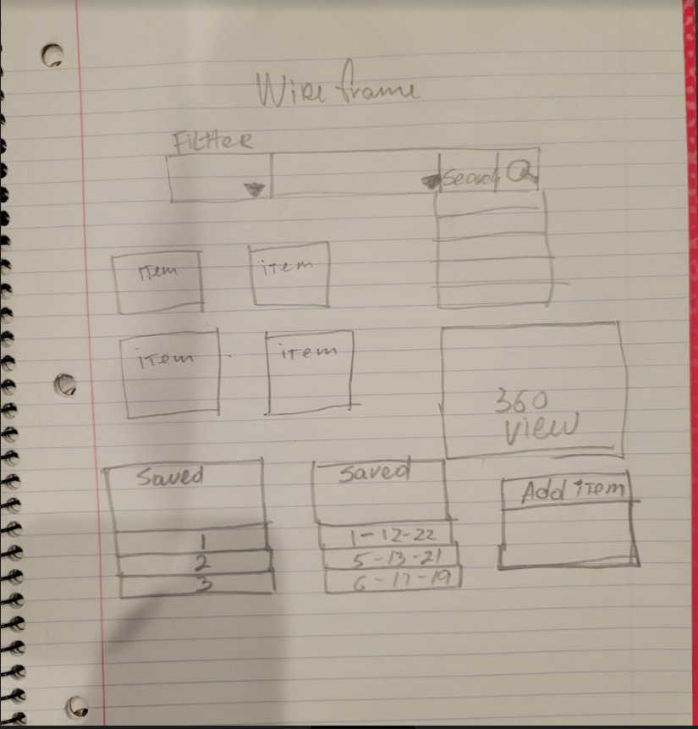
Search Bar WireFrame

Slide 12
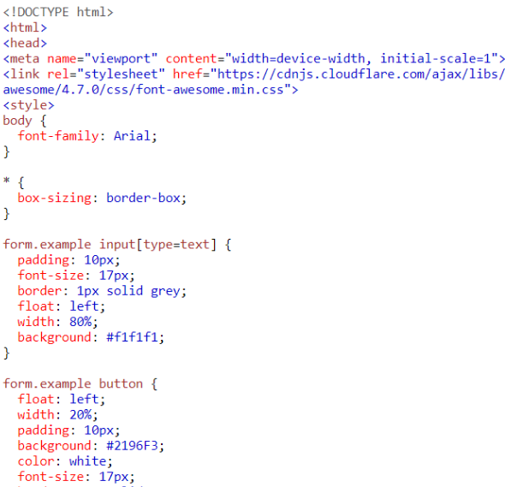
Search HTML

Slide 13
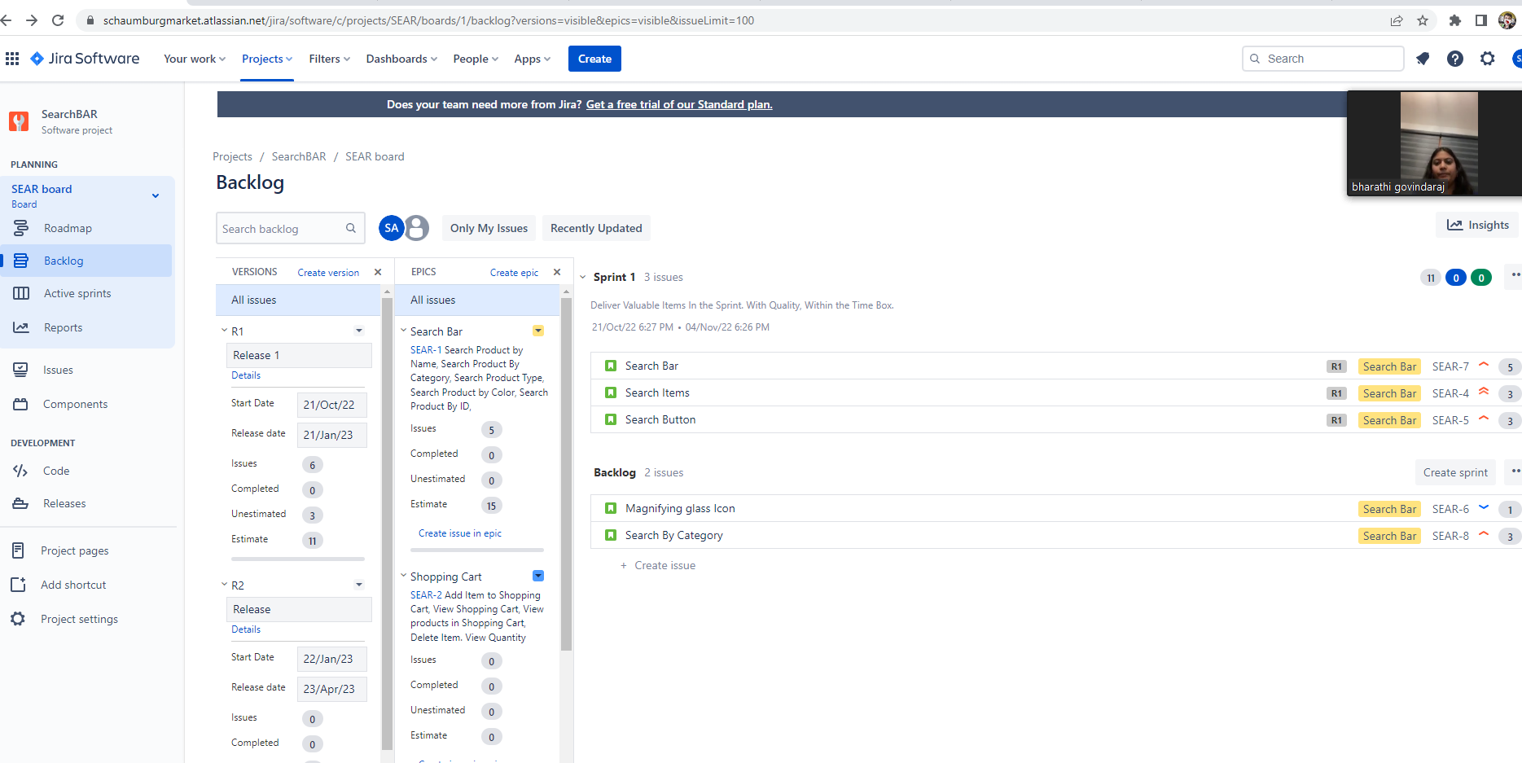
JIRA Project

Slide 14
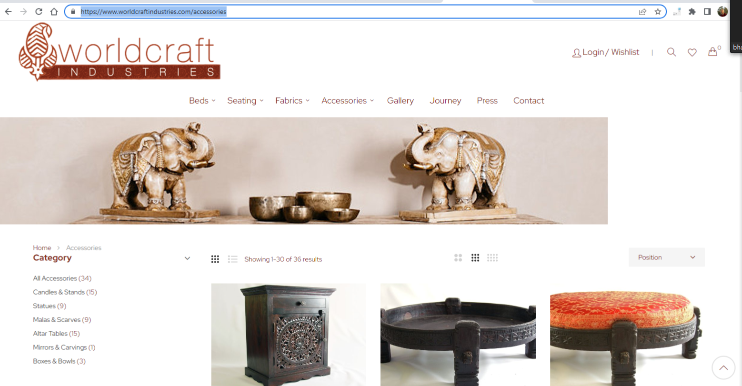
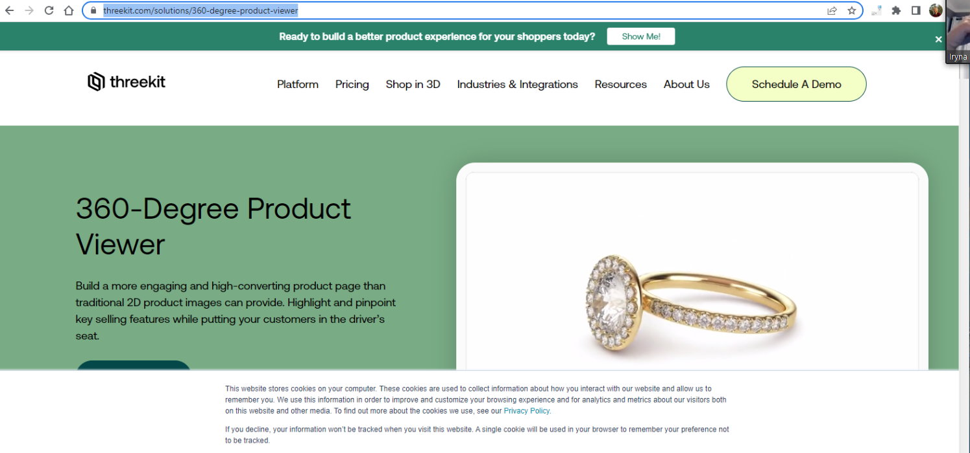
Comparative Search

Slide 15
TOOLS
Jira
MS Excel
MS Power Point
Idea Boardz
Miro Board
Zoom
Emails
Drop Box
Snip IT

Slide 16
MEETINGS / SCRUM CEREMONIES
Meetings
Business Overview Meeting
Product BL Refinement Meeting
Scrum Ceremonies
Sprint Planning
Daily Scrum
Sprint Review
Sprint Retrospective

Slide 17

Team Overview
Iryna QA Test Cases | Research | Communicating With Customer | Design | JIRA
Muhammad QA Test Cases | Brainstorming | set Meeting | JIRA |Design
Bharathi QA Test Cases | Brainstorming | Design | JIRA
Lasya QA/BA/PO Use Cases | Brainstorming | JIRA |Design
Alina BA/QA Use Diagram | Use Cases
Abdul Rahman BA
Noel PM
Ismail QA
Tien NM
Priti QA
Kenny QA
Vivek BA
SukhPal BA
Ramesh BA

